Slide 1
Hardware Hacking 101 Finding Entry Point
Jeong Wook Oh
oh.jeongwook@gmail.com

Slide 2
Objectives
Finding Vulnerabilities
Forensic Analysis
Modding
Just for fun

Slide 3
Entry Point
UART
JTAG
Storage
Bus?

Slide 4
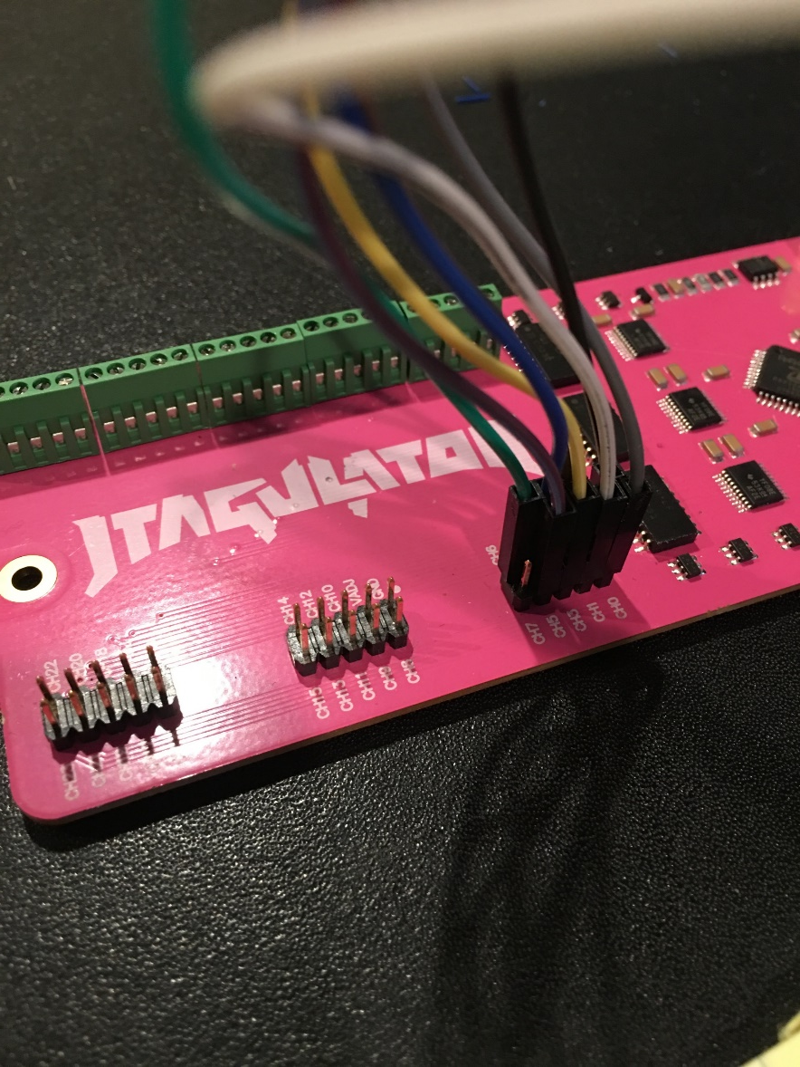
JTAGulator – automation with finding entry point

Slide 5
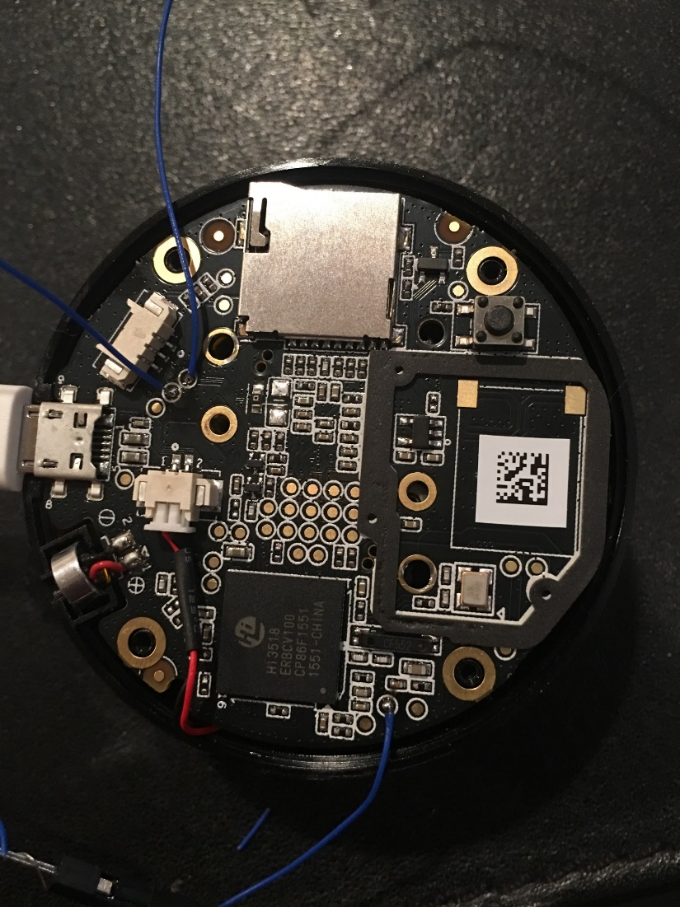
JTAGulator - works sometimes?

Slide 6
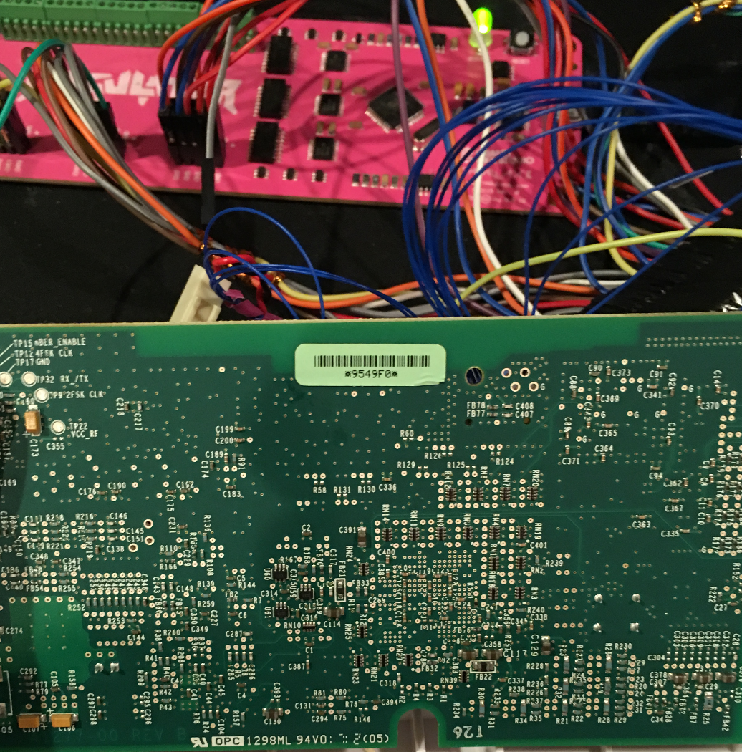
JTAGulator - usually fails

Slide 7
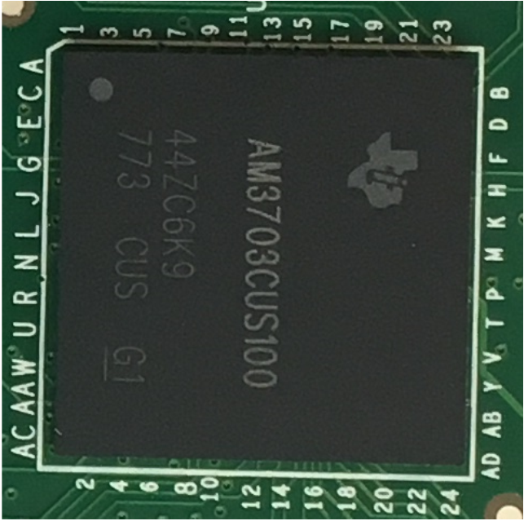
CPU

Slide 8
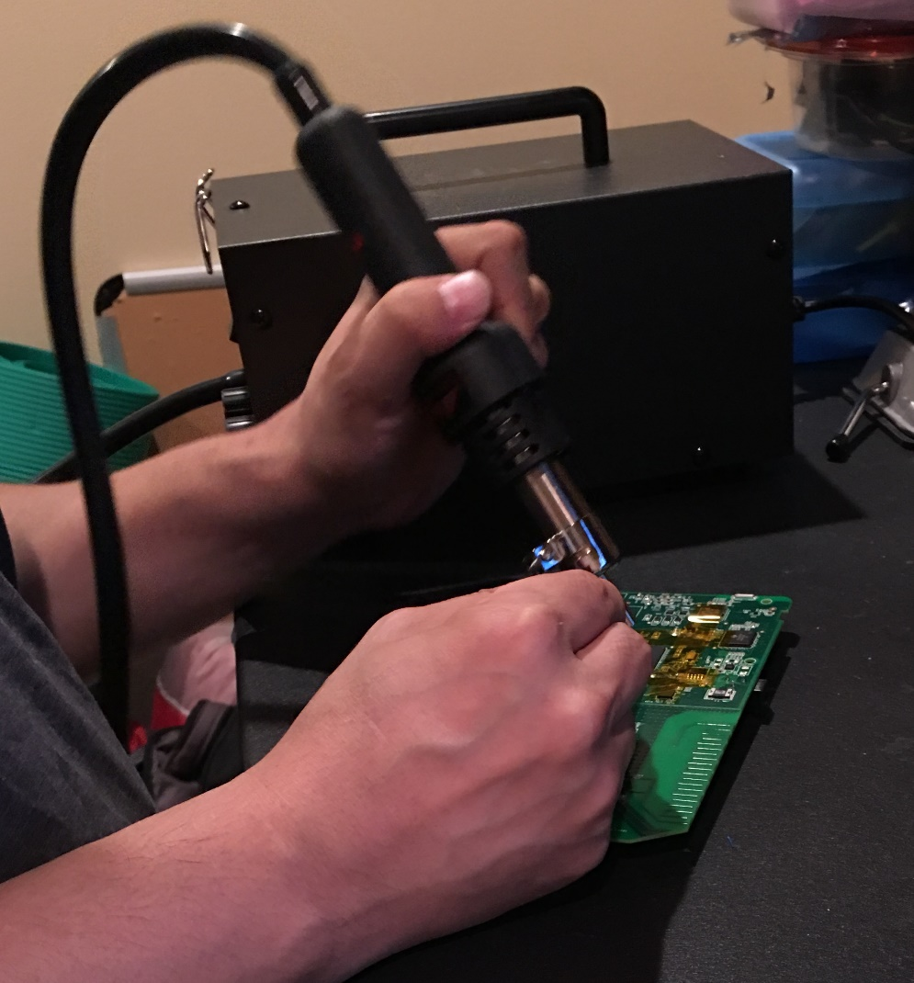
Desoldering

Slide 9

Cheap hot air blower

Slide 10
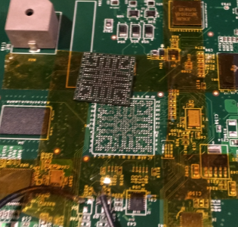
Pins exposed

Slide 11
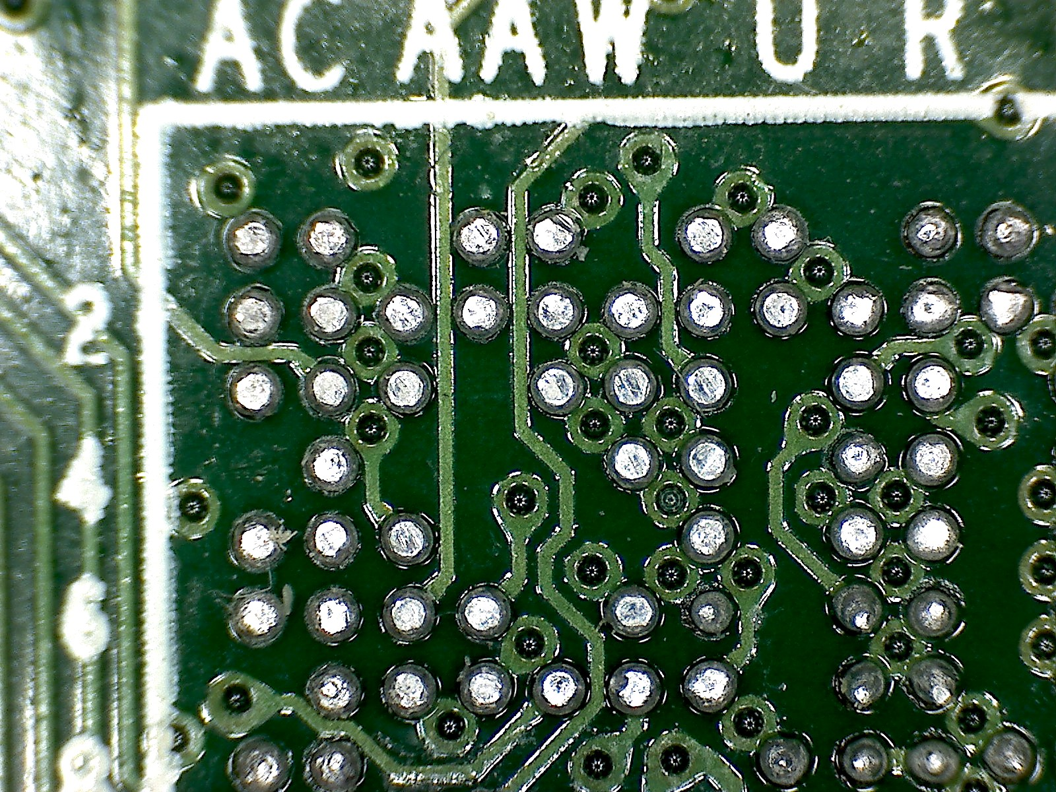
Finding pins and connection points

Slide 12
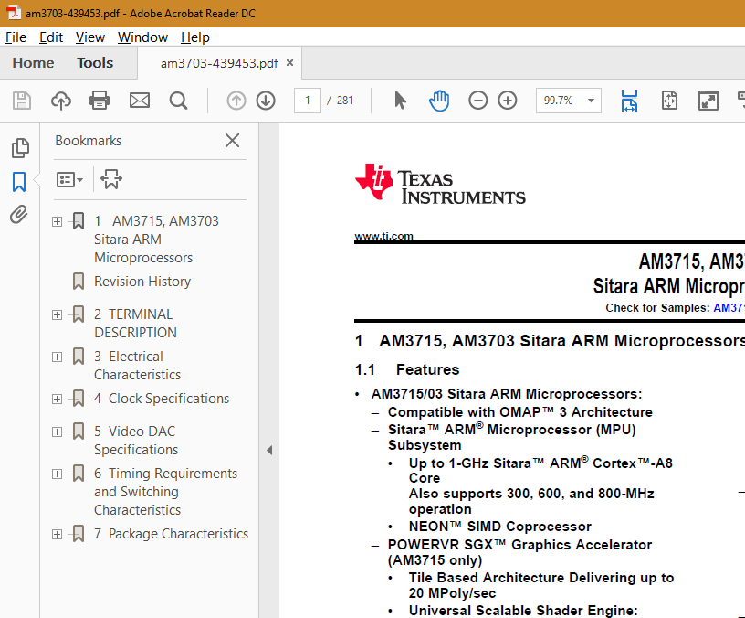
Finding spec documents

Slide 13

Pin layout

Slide 14
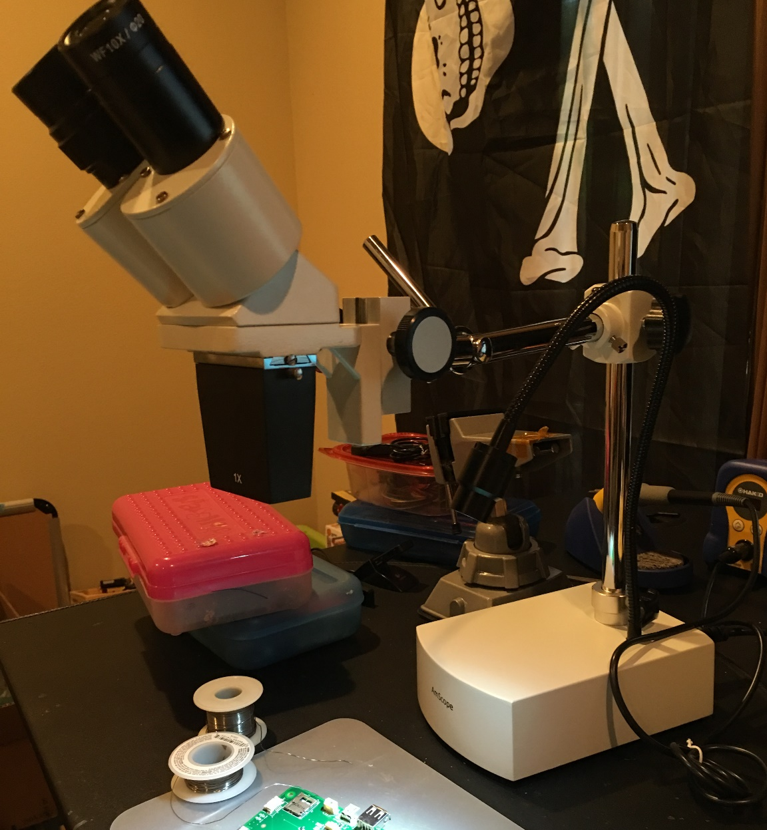
Microscope

Slide 15
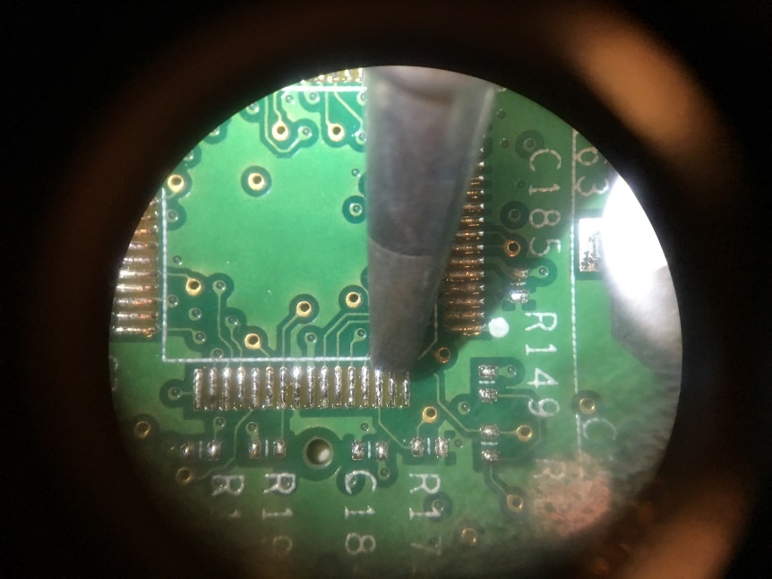
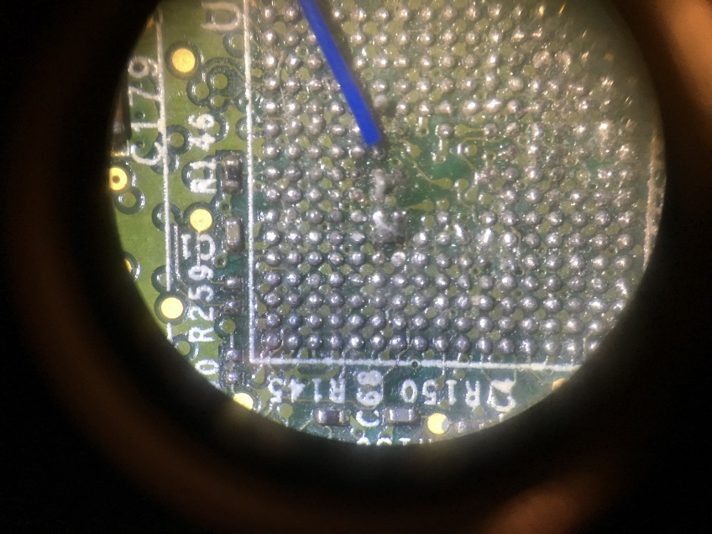
Increased performance

Slide 16
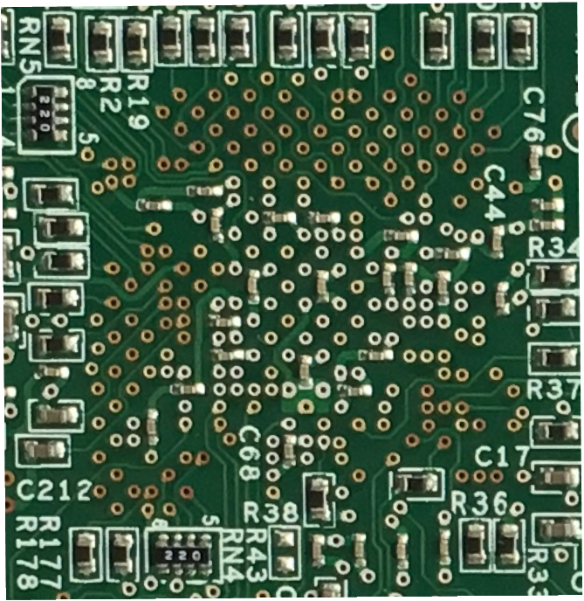
Possible connection points

Slide 17
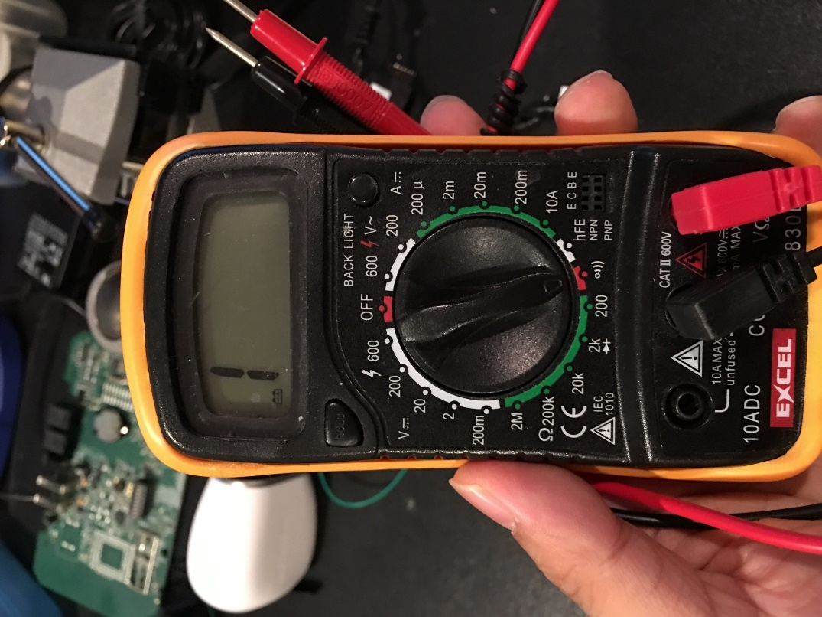
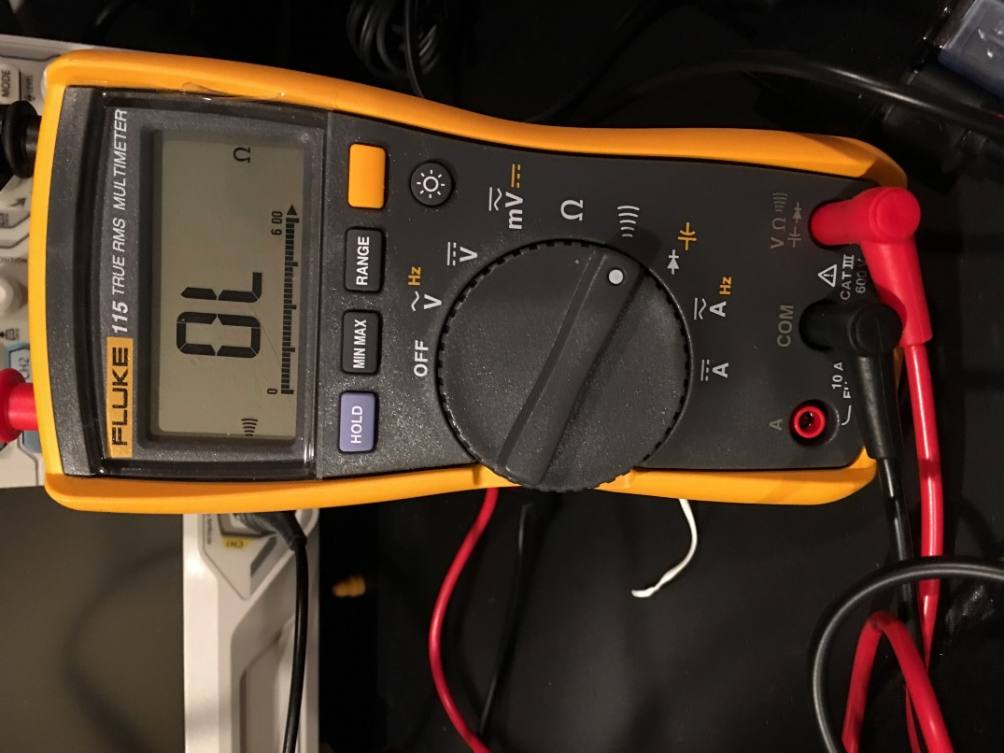
Tools of choice

Slide 18
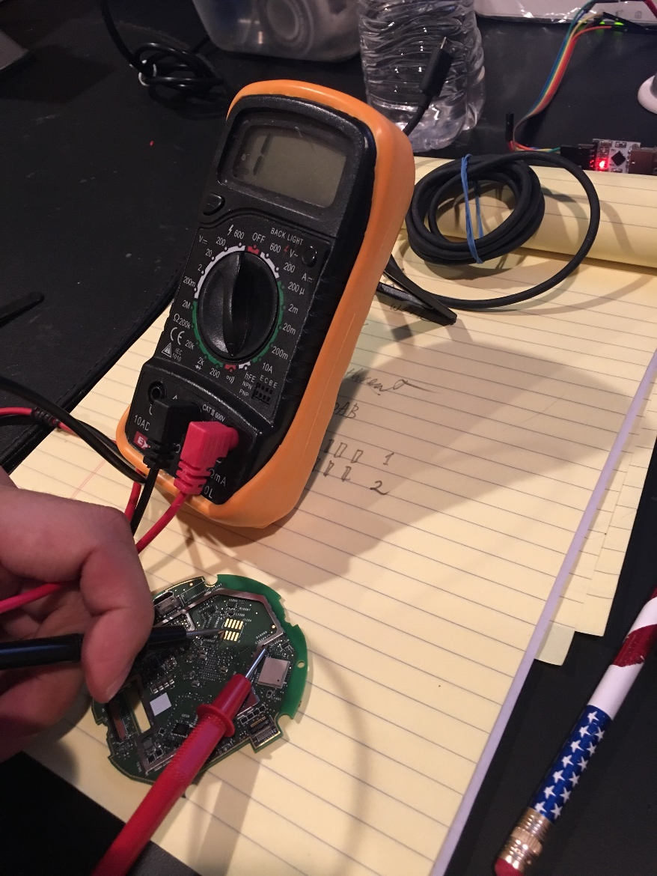
Finding ground

Slide 19
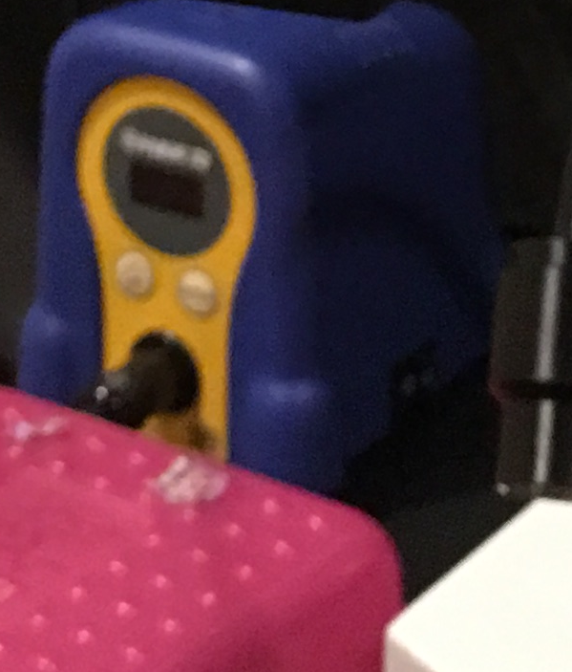
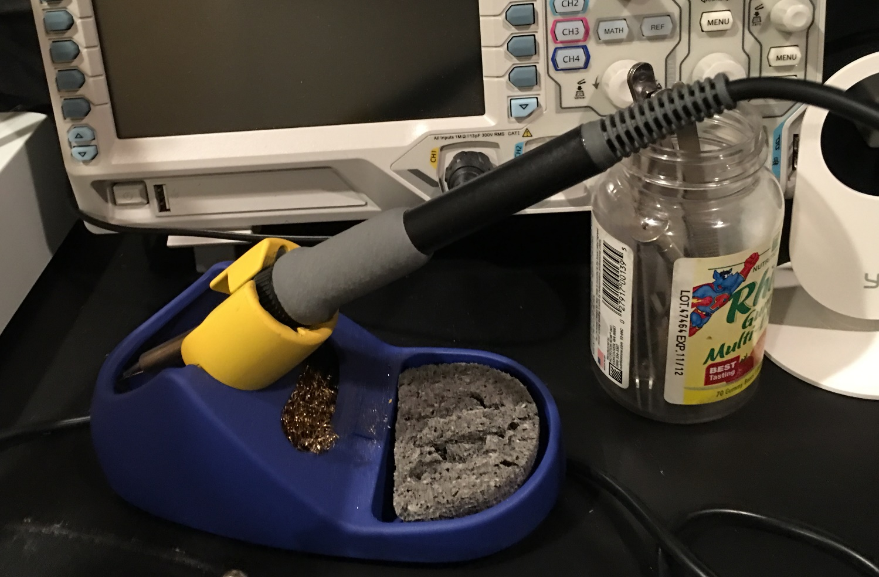
Good solder iron

Slide 20
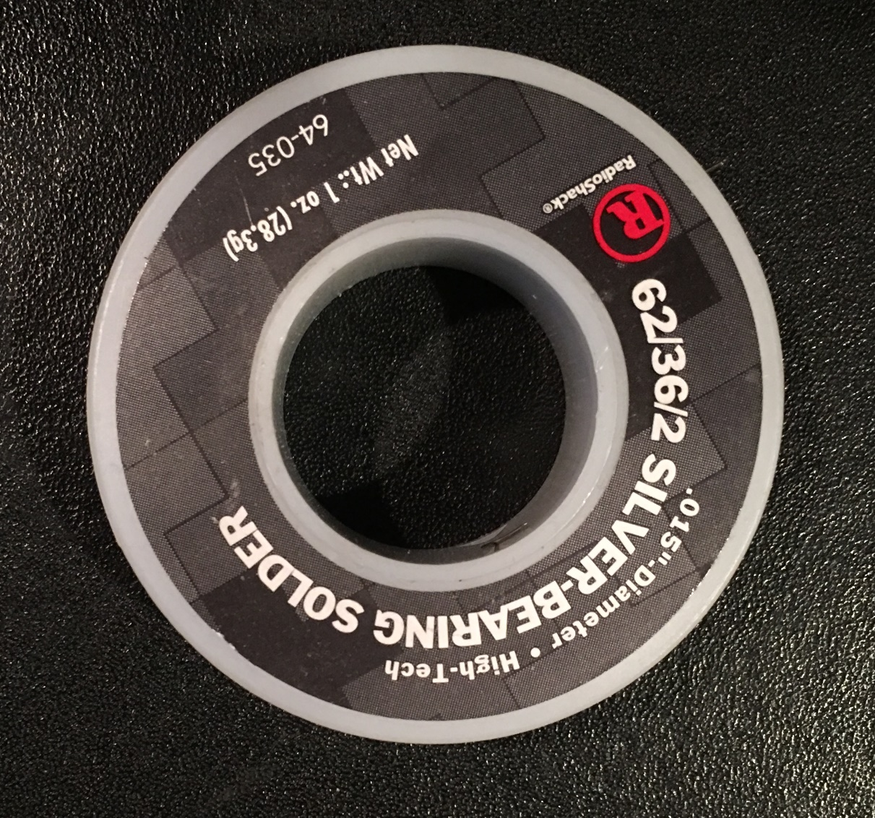
Good solder

Slide 21
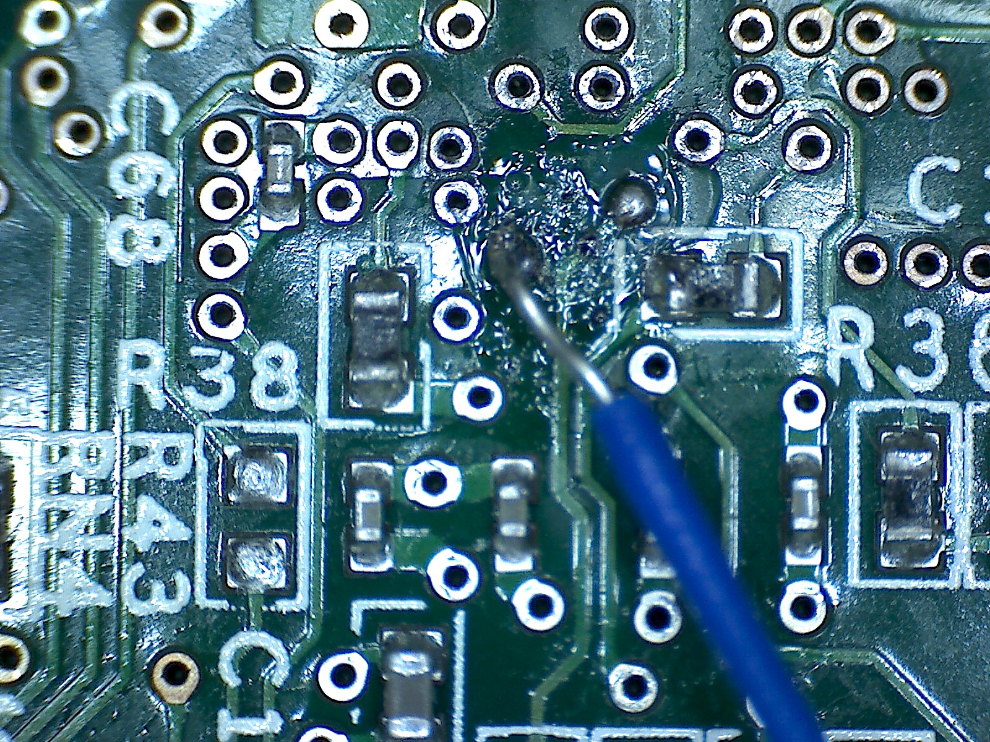
Soldering example

Slide 22
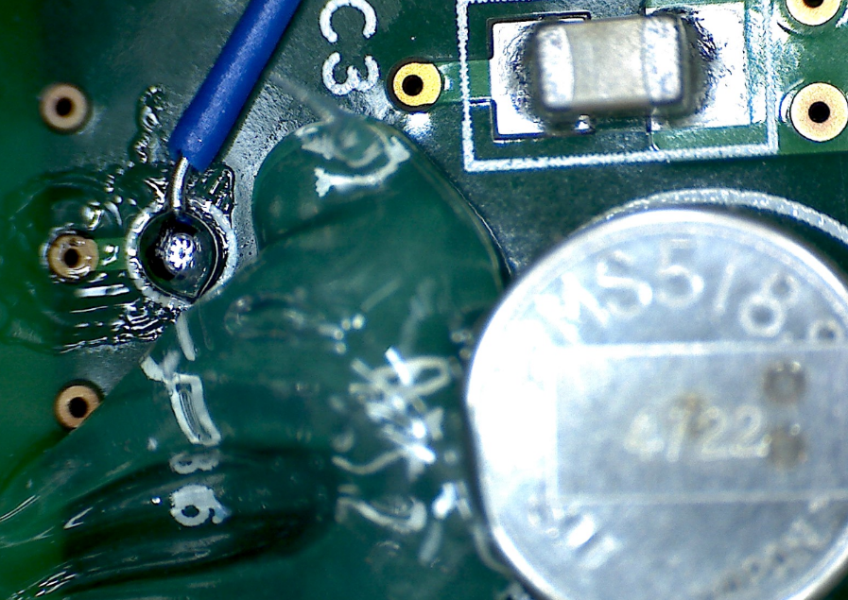
Soldering example

Slide 23
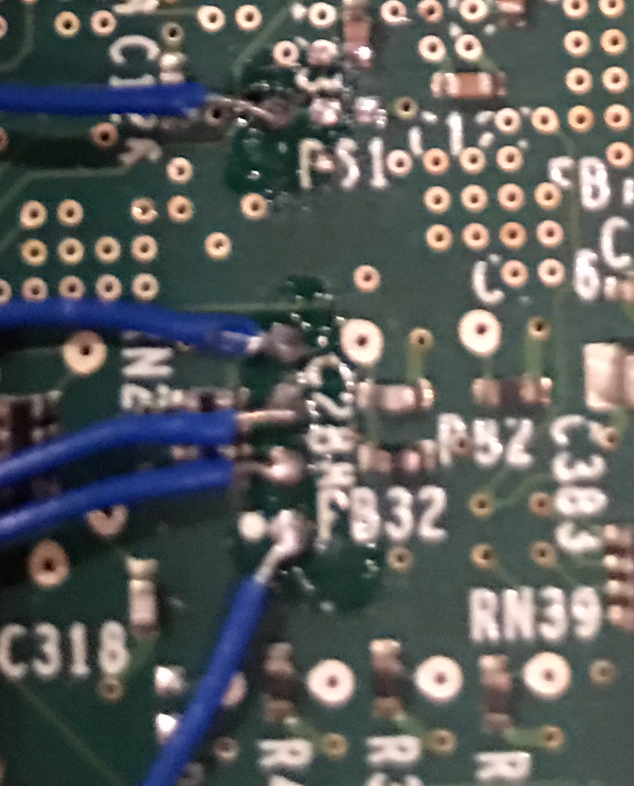
Soldering example

Slide 24
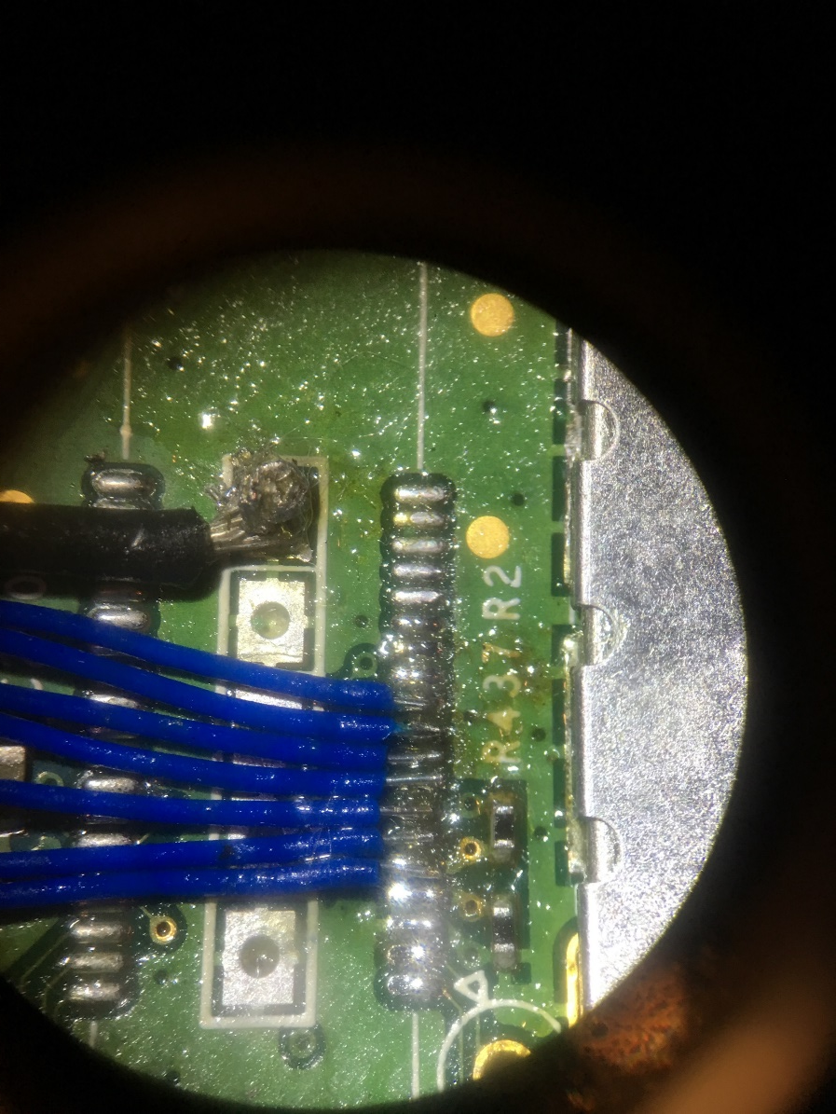
Soldering example

Slide 25
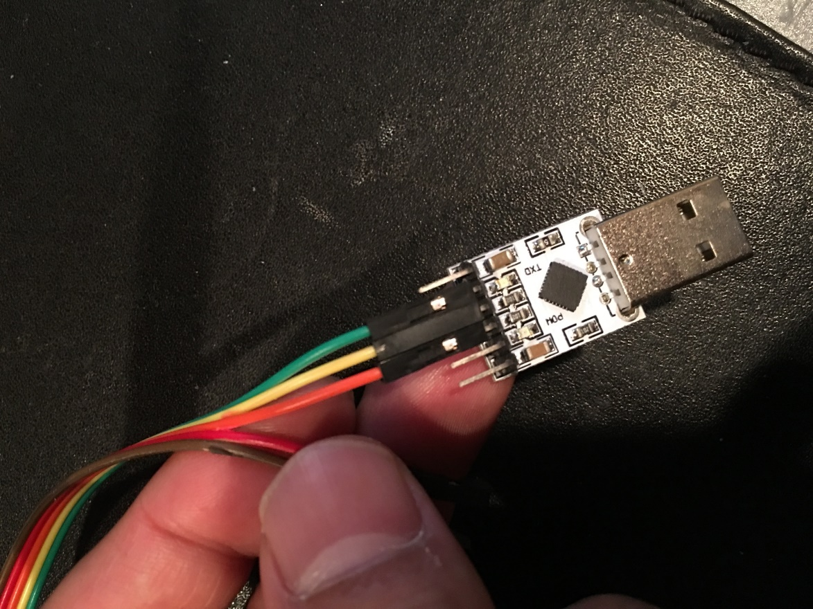
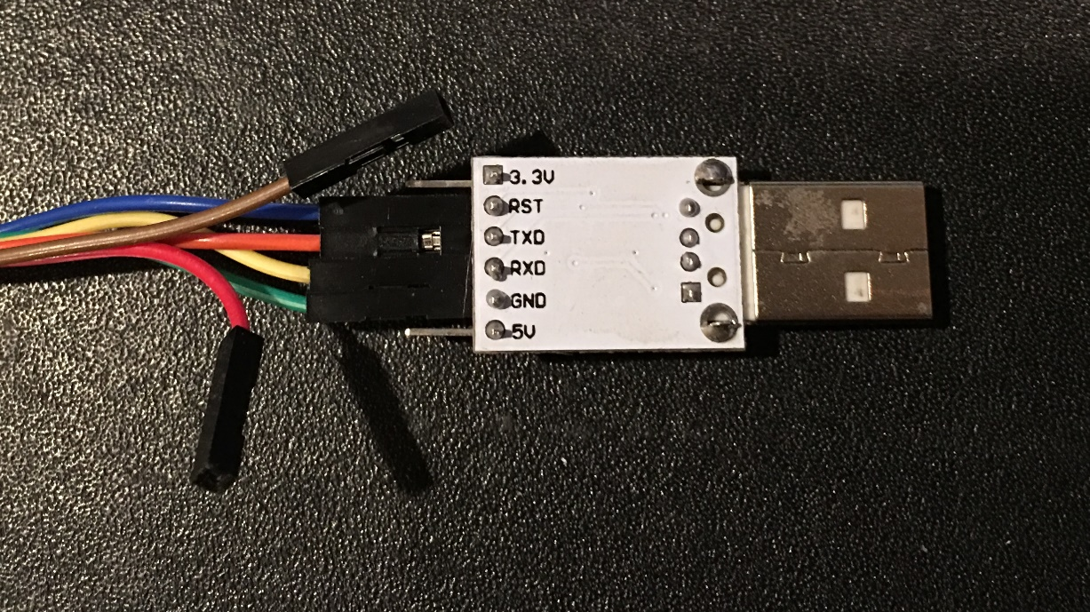
USB-to-TTL

Slide 26
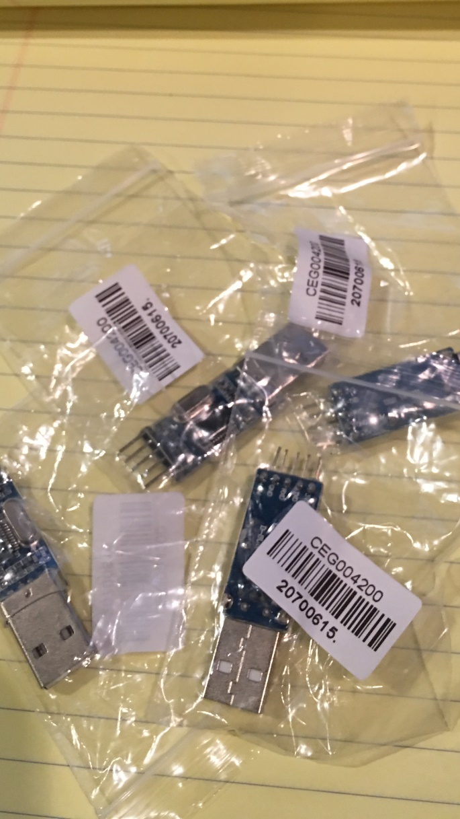
USB-to-TTL

Slide 27
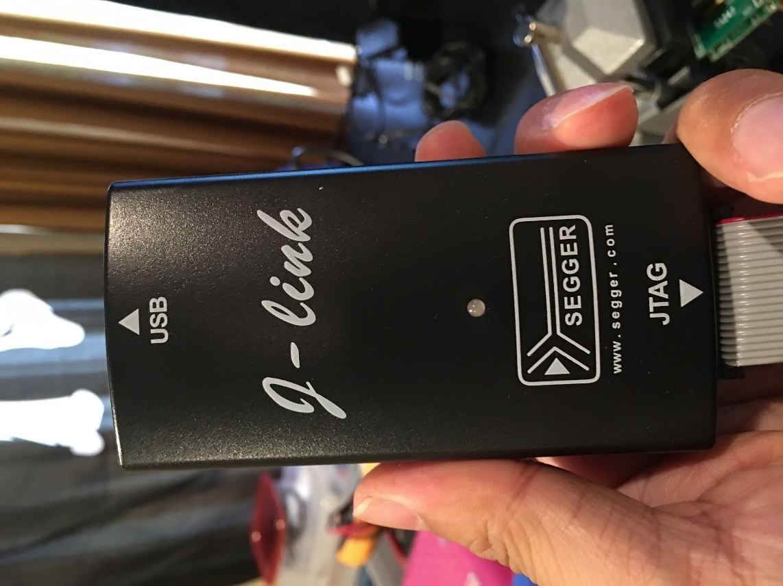
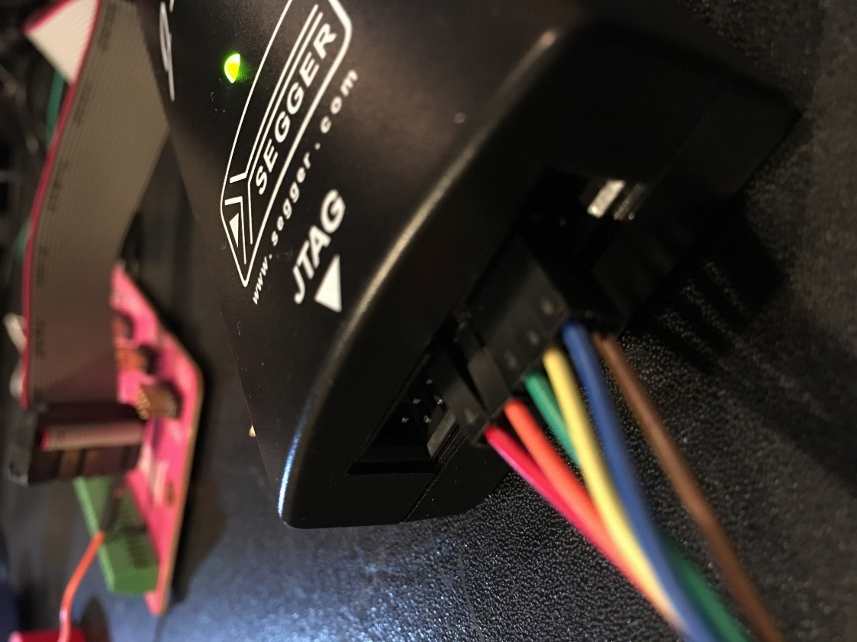
SEGGER J-Link

Slide 28
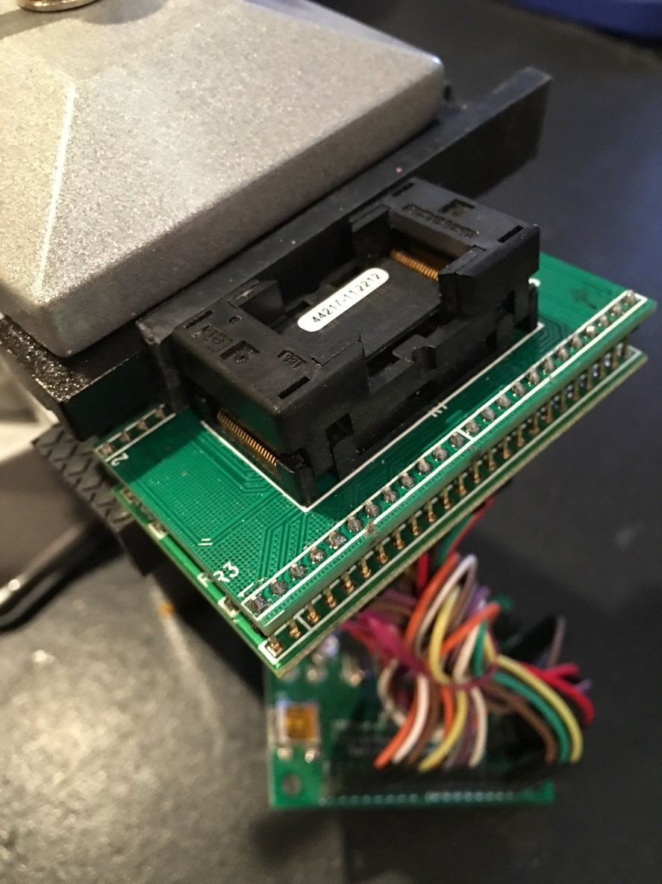
NAND Dump

Slide 29
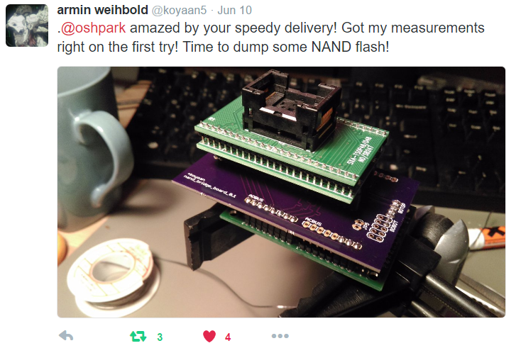
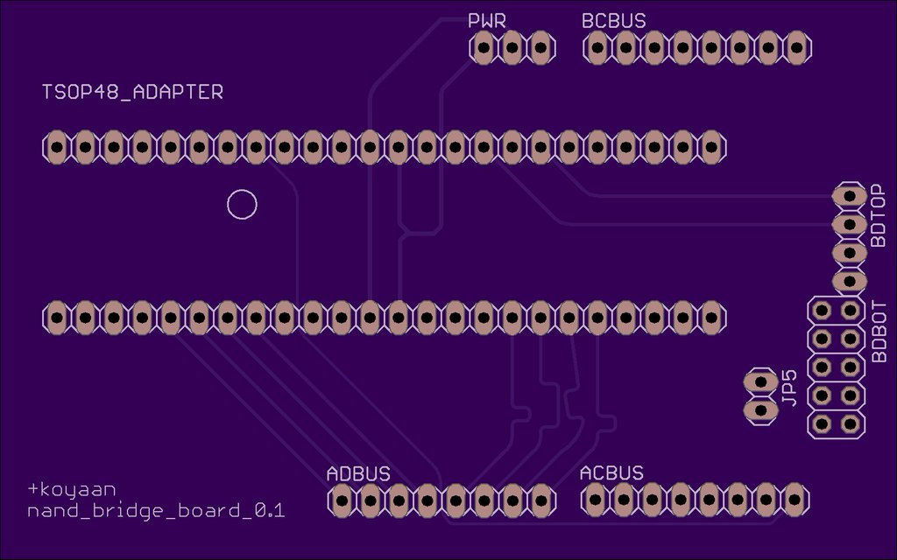
NAND Adapter

Slide 30
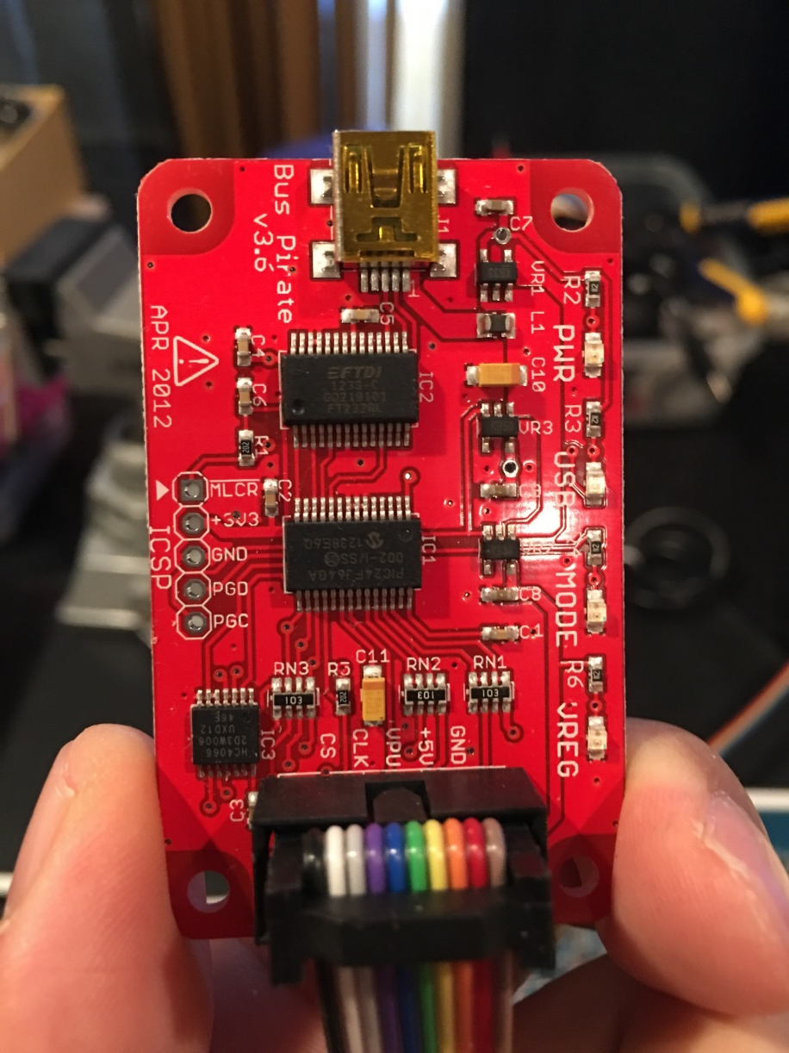
Bus pirate

Slide 31
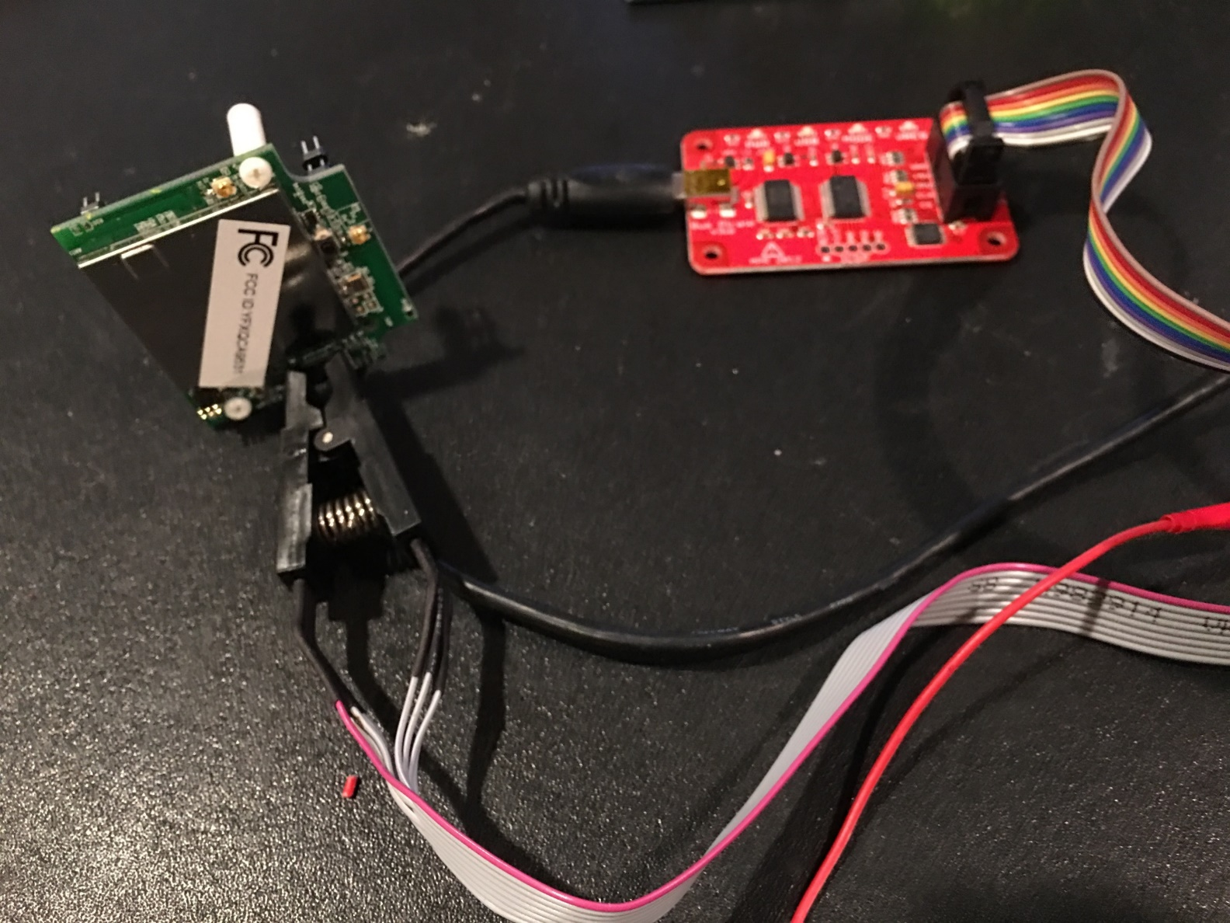
Dumping Flash memory with SPI interface

Slide 32
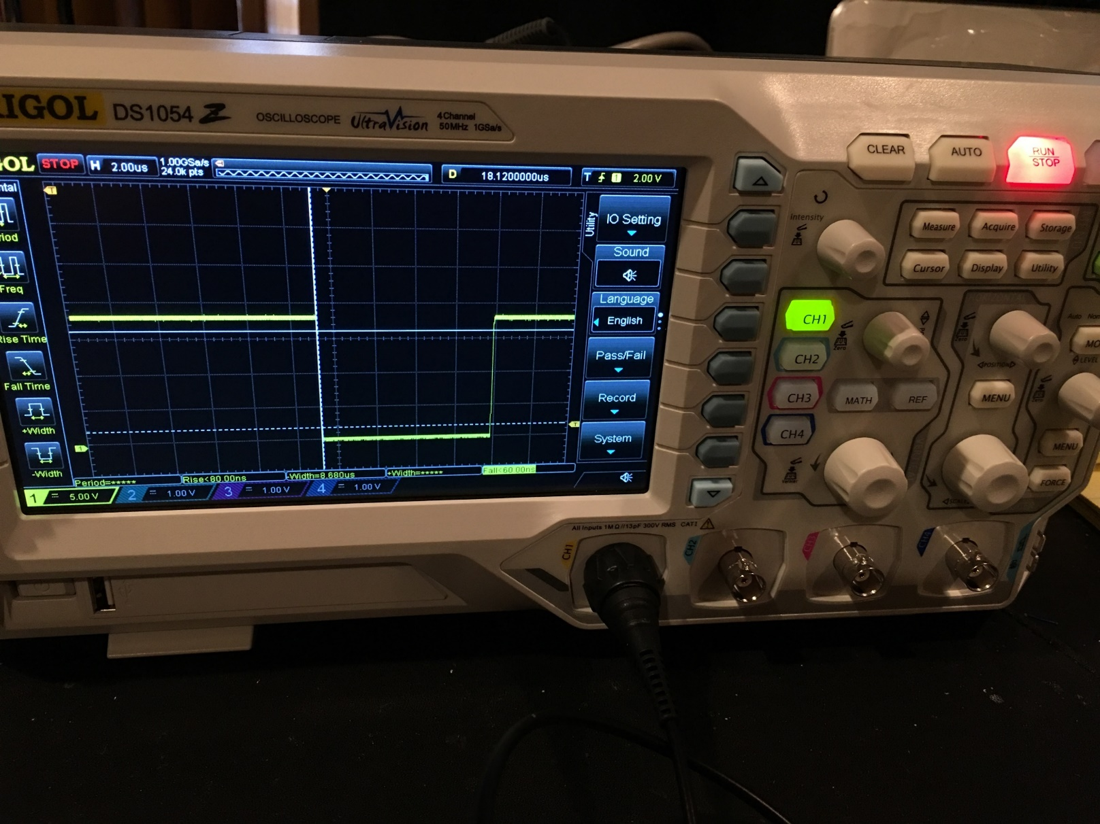
Oscillator

Slide 33
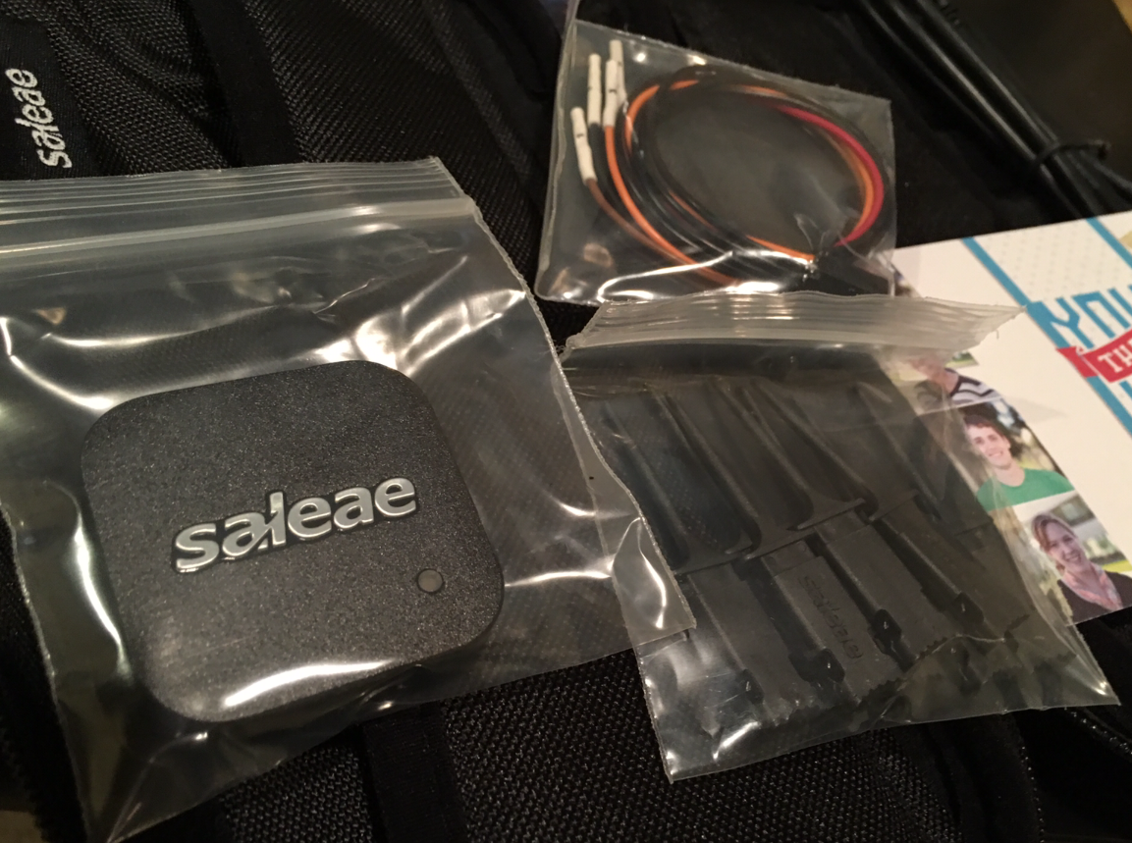
Logic analyzer

Slide 34
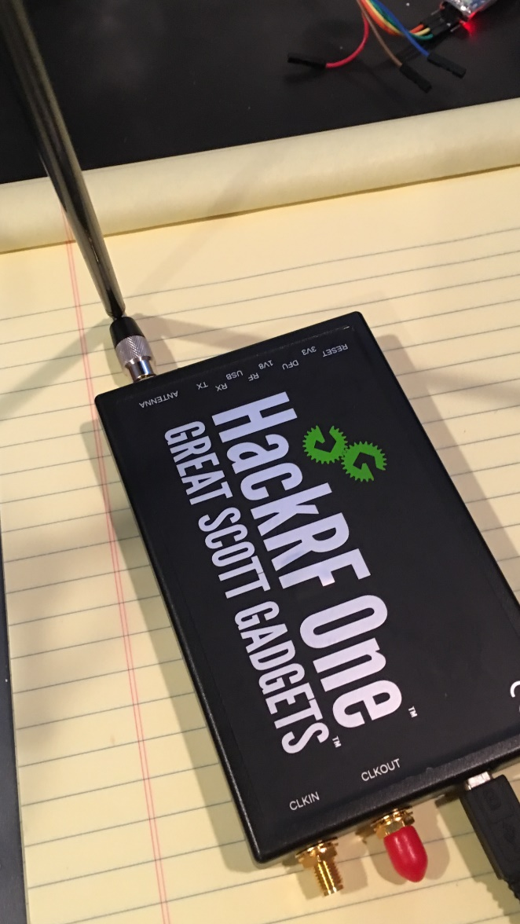
HackRF

Slide 35
Conclusion
하드웨어 해킹 – 참 쉽죠?

